Slide 1
CHANDIGARH UNIVERSITY , MOHALI , PUNJAB
DEPARTMENT OF APEX INSTITUTE OF TECHNOLOGY
AR App for visualizing interior design changes in a real-world environment
RESEARCH PAPER
Presented by : 1. MUSKAN
2. SUDIP KUMAR MAHATO
3. GARGI GHOSH
SUPERVISER : PROF. KIRTI MAM

Slide 2

Introduction to Project
Project Formulation
Objectives of the work
Main Features of the Project
OUTLINES
Methodology Used
Proposed System
Results and Outputs
Conclusion
Future Scope
References

Slide 3

INTRODUCTION TO PROJECT
Since many details are left up to the imagination of the user, it can be challenging to picture how any piece of furniture would appear in a space. The proportions, color, and degree of harmony with the environment. Augmented reality, a technology that overlays computer images on the real world, has been used in engineering and design to address practical problems.
Problem :
Traditional design methods limit visualization and user participation.
Solution :
Develop an AR application to visualize interior design changes in a real-world setting

Slide 4
INTRODUCTION TO PROJECT
Benefits :
a) Users become central to creative decisions.
b) 3D visualization enhances understanding of design modifications.
c) Experiment with spatial changes, color schemes, and furniture placement virtually.
d) Increased confidence in design choices due to immediate visual feedback.
Impact :
a) Revolutionizes the interior design process.
b) Bridges the gap between design ideas and reality.
c) Democratizes design by empowering users to personalize their living spaces.
d) Fosters innovation and creativity in interior design.

Slide 5

PROJECT FORMULATION
The current state of augmented reality (AR) systems for interior design usually makes use of mobile applications, 3D modelling tools, and AR frameworks. Solutions that improve the depiction of interior design modifications in real-world situations are available from a variety of platforms and companies. The following components are frequently included in these systems:
AR PLATFORMS AND SDKs
a) ARKit (iOS)
b) ARCore (Android)
c) Enables placement of virtual items and surface tracking
INTERIOR DESIGN APPS
a) Integration of AR Capabilities
b) Provides an immersive experience
c) Focuses on interior design and decor

Slide 6
PROJECT FORMULATION
FURNITURE RETAIL AR APPS
a) Offered by Furniture Retailers
b) Enables customers to digitally arrange furniture in their homes using AR
c) Utilizes 3D model catalogs showcasing product inventory
CUSTOMIZABLE 3D MODEL LIBRARIES
a) Large libraries of 3D models
b) Depicts furnishings, accessories, and design elements
c) Enables virtual placement options through customization and integration with AR applications

Slide 7
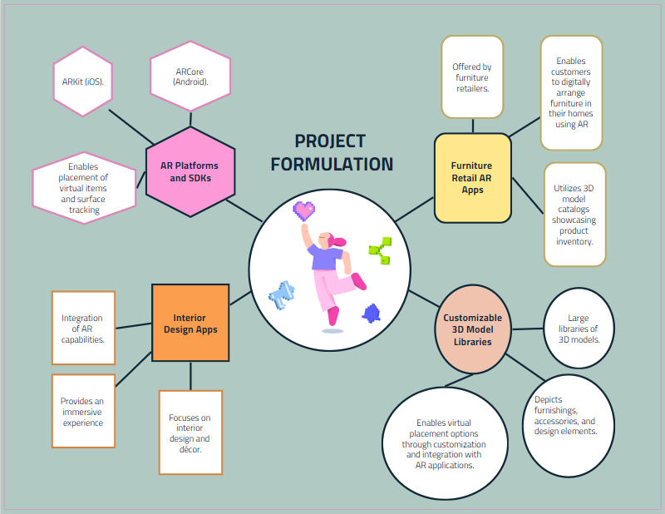
PROJECT FORMULATION

Slide 8

OBJECTIVES OF THE WORK
The objective of the work is to create an augmented reality (AR) application that allows users to visualize changes to interior design in a real-world setting. This app would empower users to make precise and confident changes to their surroundings by providing a 3D visualization of design modifications.
Here are the specific goals of the AR app:
User-Centered Design:
Put the user at the center of creative decision-making in interior design.
Enhanced Visualization :
Provide a 3D view of design modifications in the user's actual surroundings.

Slide 9
OBJECTIVES OF THE WORK
Streamlined Experience :
Simplify the interior design process by allowing virtual furniture placement and experimentation.
Increased Confidence :
Give users more confidence in their design choices by showing the immediate visual effects.
Overall, the project aims to revolutionize the interior design process by bridging the gap between idea and reality through the use of AR technology.

Slide 10

MAIN FEATURES OF PROJECT
A complete and user-centric platform is envisioned for the Augmented Reality (AR) software, which is intended to visualize changes in interior design in a real-world setting. Modern features and technologies are integrated into the system to give users who are involved in interior design a smooth and immersive experience. A summary of the main elements and features of the suggested system is provided below:
AUGMENTED REALITY INTEGRATION
EXTENSIVE 3D MODEL LIBRARY
CLOUD-BASED STORAGE FOR DESIGNS
INTEGRATION WITH ONLINE STORES
REAL WORLD VISUALIZATION

Slide 11
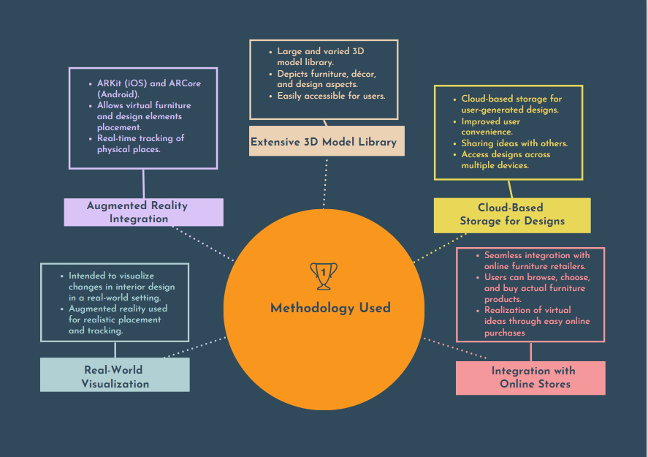
MAIN FEATURES OF PROJECT
Features of Project

Slide 12
METHODOLOGY USED
As the current state of augmented reality (AR) systems for interior design usually makes use of mobile applications, 3D modelling tools, and AR frameworks. Solutions that improve the depiction of interior design modifications in real-world situations are available from a variety of platforms and companies.
So to design our system for user benefits we have used a methodology that is defined below :
REQUIREMENT ANALYSIS
RESEARCH AND INSPIRATION
CONCEPTUALIZATION AND DESIGN
DEVELOPMENT
TESTING AND FEEDBACK

Slide 13
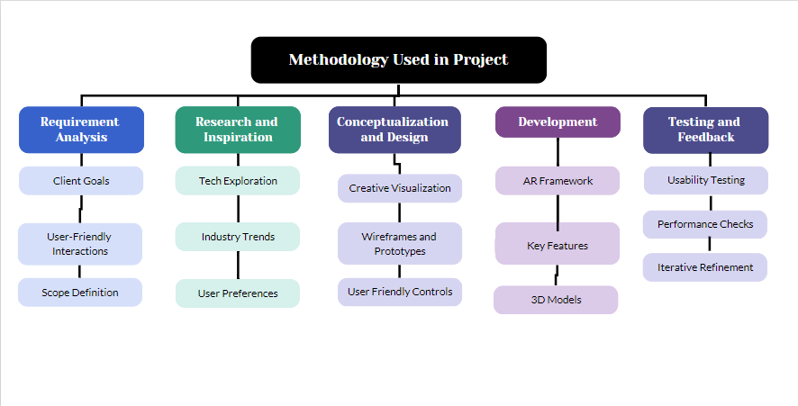
METHODOLOGY USED

Slide 14
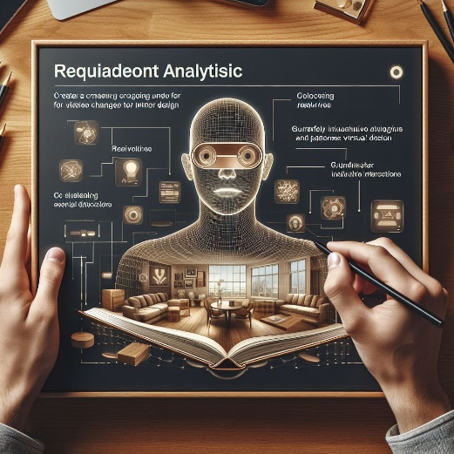
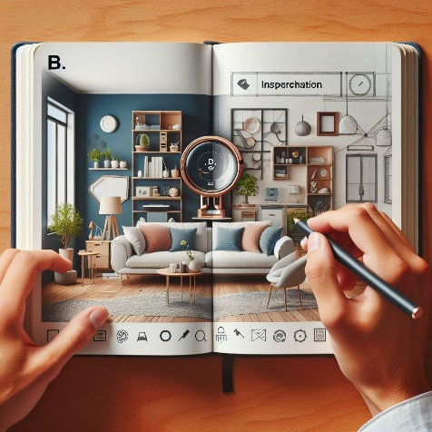
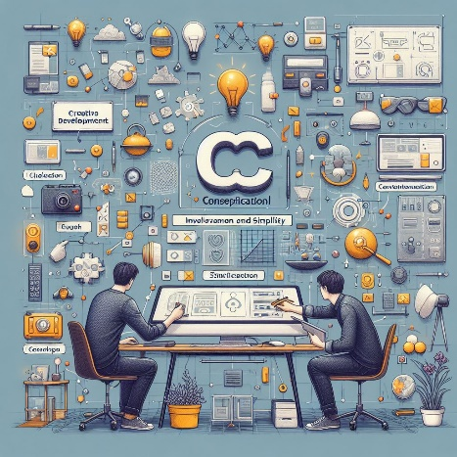
METHODOLOGY USED
REQUIREMENT ANALYSIS
RESEARCH AND INSPIRATION
CONCEPTUALIZATION AND DESIGN

Slide 15
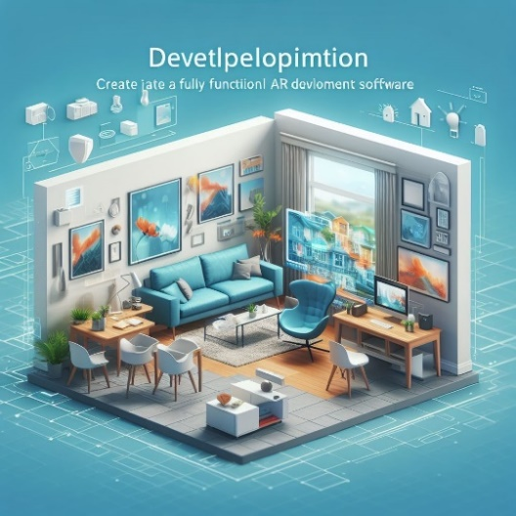
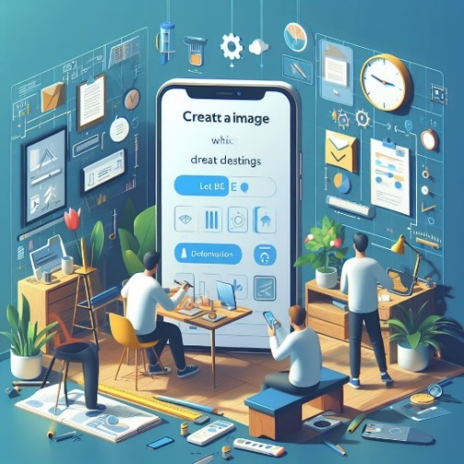
METHODOLOGY USED
DEVELOPMENT
TESTING AND FEEDBACK

Slide 16

PROPOSED SYSTEM
Introducing our advanced augmented reality app that enables you to visualize changes to interior design in real spaces.
Our technology is optimized for performance and provides a user-friendly interface that revolutionizes how people interact with interior design.
The proposed system developed for the AR app consists of the following features:
PERSONALISATION CHOICES
TRACKING WITHOUT MARKERS
COMBINING DESIGN SERVICES WITH INTEGRATION
OFFLINE MODE
OPTIMIZING PERFORMANCE

Slide 17
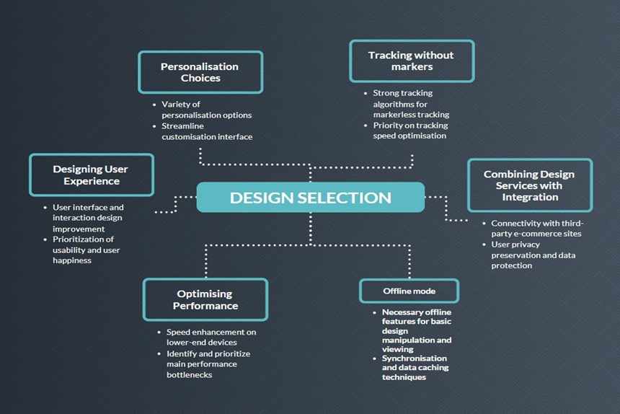
PROPOSED SYSTEM

Slide 18

RESULTS AND OUTPUTS
Our development of an augmented reality (AR) app for visualizing interior design within real-world environments highlights its effectiveness across diverse demographics and professional fields.
Below are the characteristics of the AR app that we have developed:
SIGN-IN PAGE INTEGRATION
VISUALIZATION FOR VARIED AGE GROUPS
USER EXPERIENCE AND ACCESSIBILITY
COMPREHENSIVE 3D LIBRARIES REALISTIC VISUALIZATION
COLLABORATIVE FEATURES WITH ONLINE RETAILERS
SEAMLESS ACCESS TO CLOUD STORAGE

Slide 19
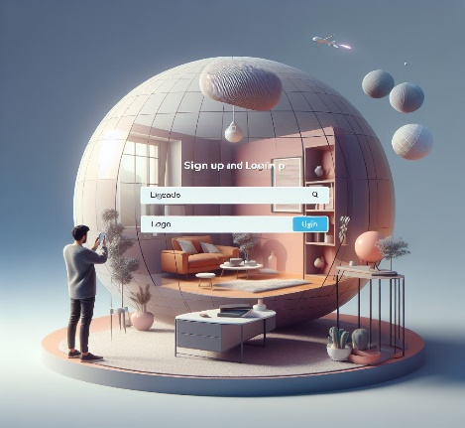
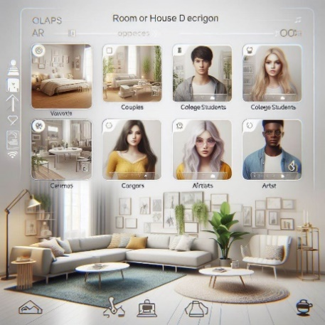
RESULTS AND OUTPUTS
SIGN-IN PAGE INTEGRATION
VISUALIZATION FOR VARIED AGE GROUPS

Slide 20
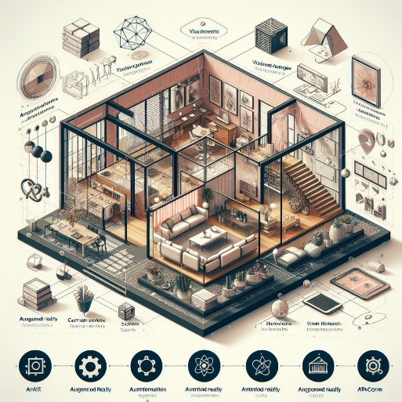
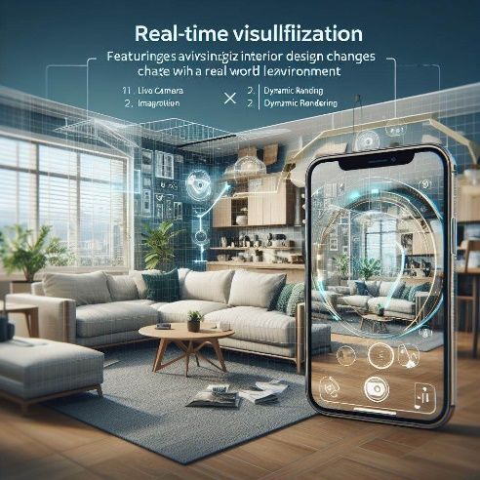
RESULTS AND OUTPUTS
USER EXPERIENCE AND ACCESSIBILITY
COMPREHENSIVE 3D LIBRARIES REALISTIC VISUALIZATION

Slide 21
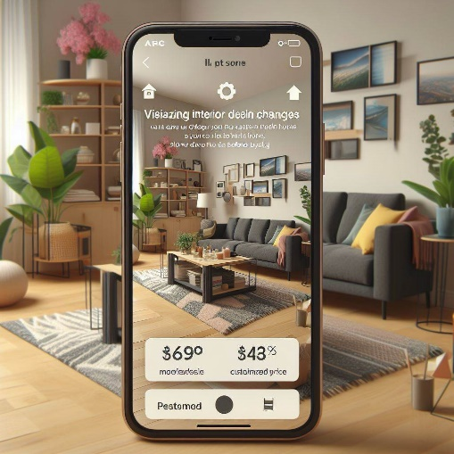
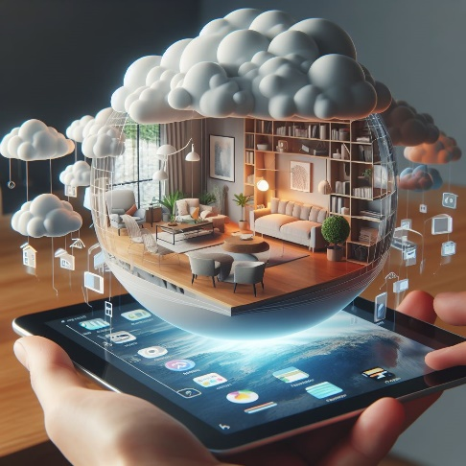
RESULTS AND OUTPUTS
COLLABORATIVE FEATURES WITH ONLINE RETAILERS
SEAMLESS ACCESS TO CLOUD STORAGE

Slide 22

CONCLUSION
Our experience creating augmented reality software that enables users to visualize interior design in real-world settings shows that the app is adaptable to a wide range of age groups and professional backgrounds. The inclusion of a sign-up page that requires a login and password for authentication not only increases user engagement and accessibility but also underscores the importance of safeguarding user privacy and data within AR application ecosystems.
Moreover, accessibility, collaboration, and personalization in interior design visualization have improved significantly with the integration of cloud storage and online store collaboration into the AR app ecosystem. These features enable users to create immersive and customized creative experiences, foster teamwork, and streamline the procurement process by providing easy access to design files and product catalogs.

Slide 23

FUTURE SCOPE
Our development of an augmented reality (AR) app for visualizing interior design within real-world environments highlights its effectiveness across diverse demographics and professional fields.
Below Can Be The Future Scope For Our AR App That We Have Developed:
AI POWERED RECOMMENDATIONS
INTELLECTUAL PROPERTY RIGHTS – USER DATA PRIVACY
SECURE CLOUD STORAGE FOR USER DATA
PERFORMANCE OPTIMIZATION AND USER - FRIENDLINESS
USE AR TECHNOLOGY FOR VIRTUAL FURNITURE AND DESIGN INTEGRATION
PERFORMANCE OPTIMIZATION

Slide 24
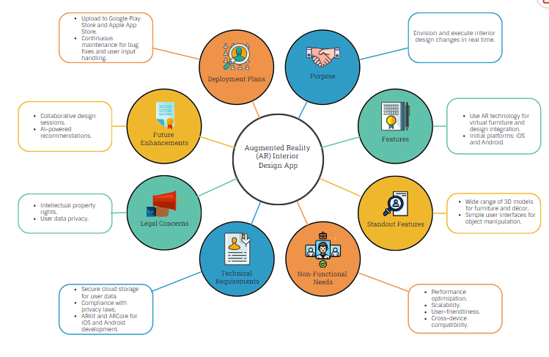
FUTURE SCOPE

Slide 25

REFERENCES
Visualization analysis of architectural interior design combined with virtual reality technology under new process conditions - Chongqing Vocational Institute of Engineering, Chongqing, 402260, China.
The Application of Augmented Reality in Interior Design Education NordDesign 2018 August 14-17, 2018 Linköping, Sweden
Automatic Interior Design in Augmented Reality Based on Hierarchical Tree of Procedural Rules. Institute of Visual Computing and Human-Centered Technology, TU Wien, 1040 Vienna, Austria. Department of Computer Science, Aarhus University, 8000 Aarhus, Denmark. COZYO, 1030 Vienna, Austria
Interior Design using Augmented Reality International Research Journal of Engineering and Technology (IRJET) Volume: 08 Issue: 04 | Apr 2021
Augmented Virtual Reality and 360 Spatial Visualization for supporting user-engaged design journal of Computational Design and Engineering, Volume 10, Issue 3

Slide 26
REFERENCES
Computer Engineering Department, College of Engineering and Applied Sciences, American University of Kuwait, Salmiyah, Kuwait ISBN: 978-989-758-538-8; ISSN: 2184-3244
Tang, J.K.T., Wan-Man Lau, Kwun-Kit Chan, Kwok-Ho To, "AR Interior Designer: Automatic Furniture Arrangement using Spatial and Functional Relationships", Virtual Systems & Multimedia (VSMM), 2014 International IEEE International Conference, pp.345 – 352, 2014
Klein, G , Murray, D, "Parallel Tracking and Mapping on a camera phone", Mixed and Augmented Reality, 2009. ISMAR 2009. 8th IEEE International Symposium, pp.83 – 86, 2009
Matsuoka, H., Onozawa, A., Hosoya, E., "Environment mapping for objects in the real world: a trial using ARToolKit", Augmented Reality Toolkit, The First IEEE International Workshop, 2002

